Slide 1


Slide 2
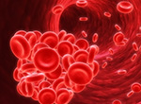
Role of Fibrinogen Supplementation in Goal Directed Hemostatic Therapy in Cardiac Surgery
Rasoul Azarfarin MD, FACC
Professor of Anesthesiology
Fellowship of Cardiac Anesthesia
Rajaie Cardiovascular Medical & Research Center

Slide 3
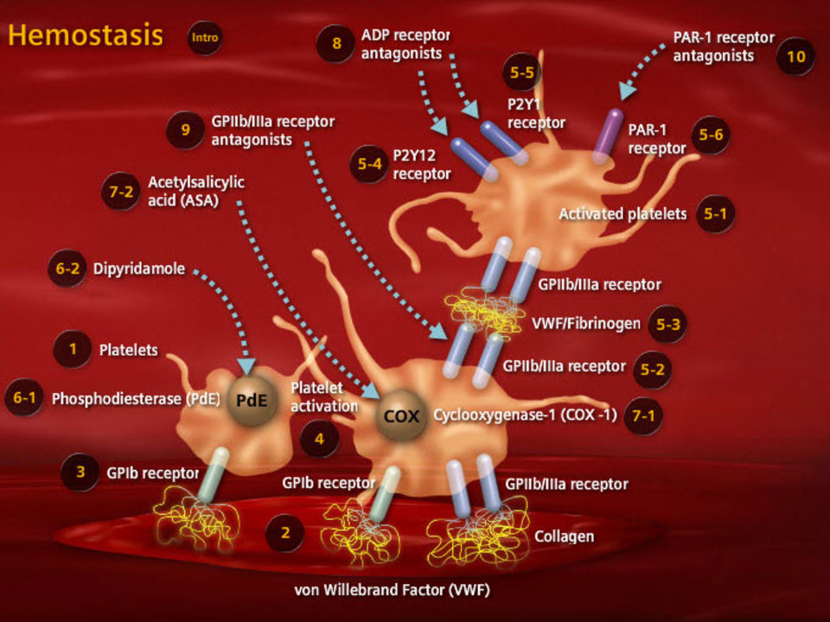

Slide 4
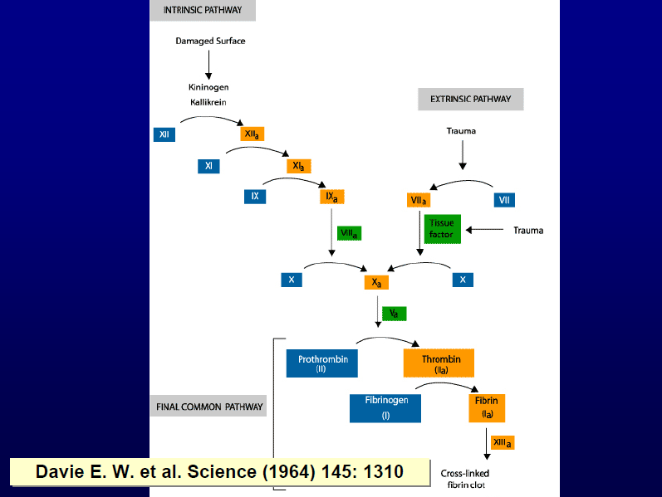

Slide 5
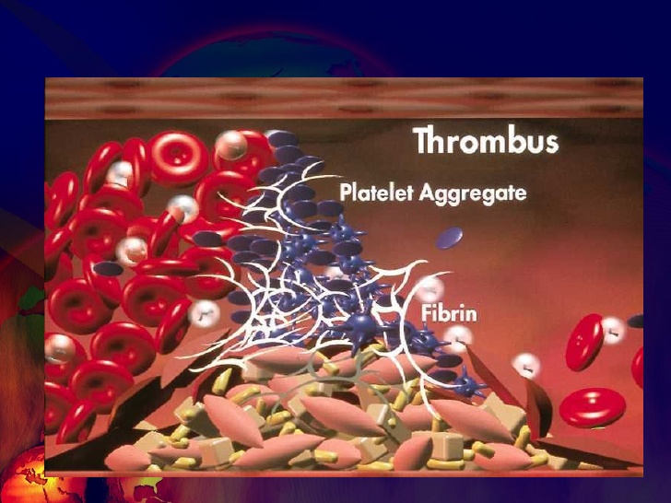

Slide 6
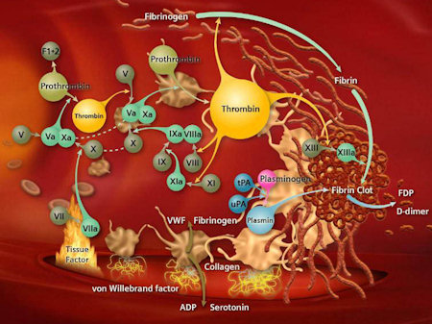

Slide 7
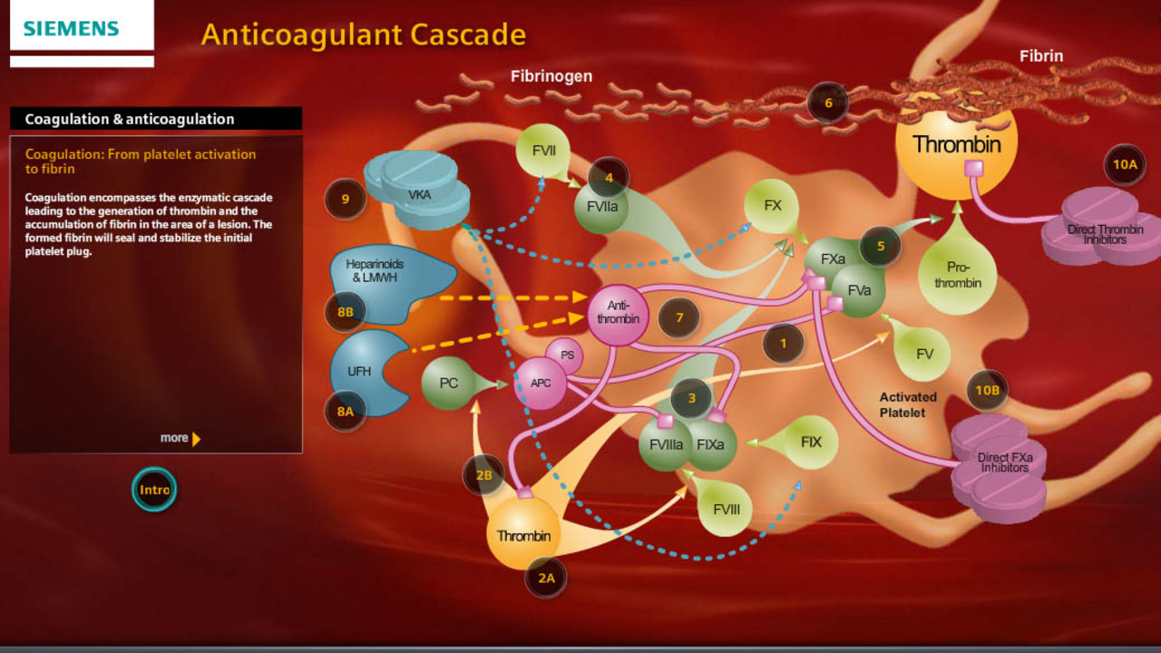

Slide 10
Coagulation factors dynamics in massive blood loss
65% blood loss
142% blood loss
201% blood loss
230% blood loss
236% blood loss
Fibrinogen reaches critical level 1g/dL
Prothrombin reaches critical level
Platelets and factor V reach critical level
Factor VII reaches critical level
Study performed in N=60 patients with average blood loss was 65% +/- 41% of the calculated blood volume (CBV). Blood samples were obtained at the induction of anesthesia and at the end of the recovery room period, or before the patient was given fresh frozen plasma. In addition, a platelet count was determined after each 20% blood loss.
Deficiency of fibrinogen develops earlier than any other hemostatic abnormality
Hiipala et al., Anesth Analg. 1995 Aug;81(2):360-5.

Slide 11
Hemostasis monitoring
Individualised goal directed therapy

Slide 12
Point of Care Tests for Post-CPB Bleeding
Coagulation factor deficiency | PT/INR aPTT | Thromboelasto-graphy
Thrombo-cytopenia | Coulter counter | Thromboelasto-graphy
Platelet dysfunction | Platelet aggregometry | Modified Coulter counter | Thromboelasto-graphy
Fibrinolysis | Thromboelasto-graphy
Residual heparin | Activated clotting time & variants | Heparin concentration | Thromboelasto-graphy
Anemia | Hemoglobin-ometer | Spun hematocrit | Coulter counter

Slide 13
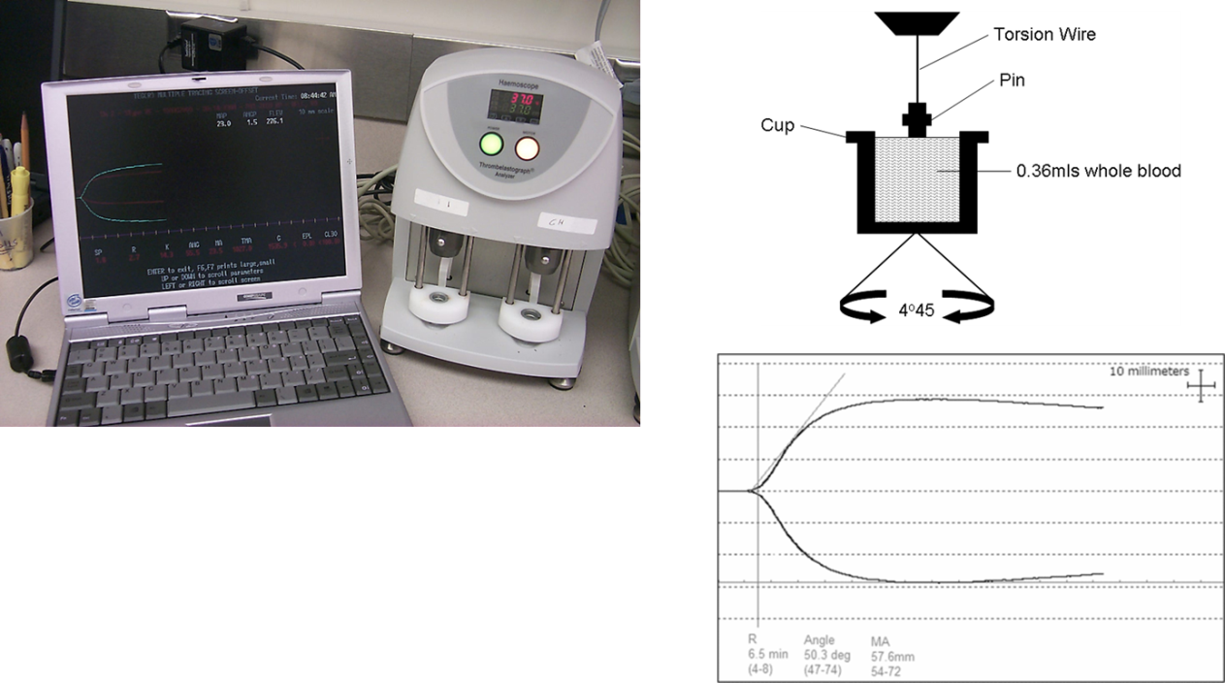
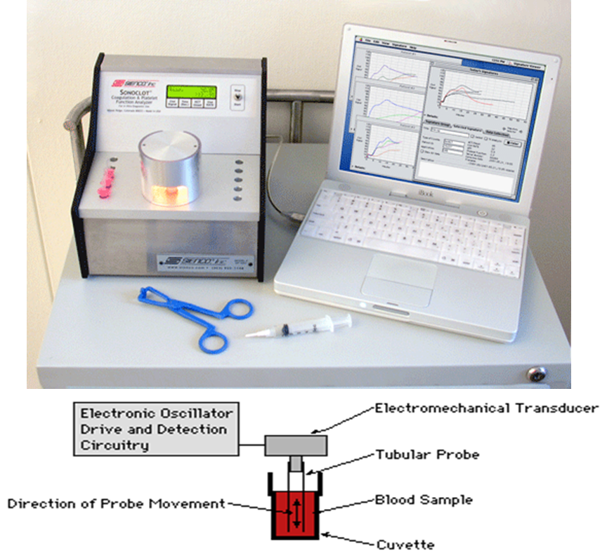
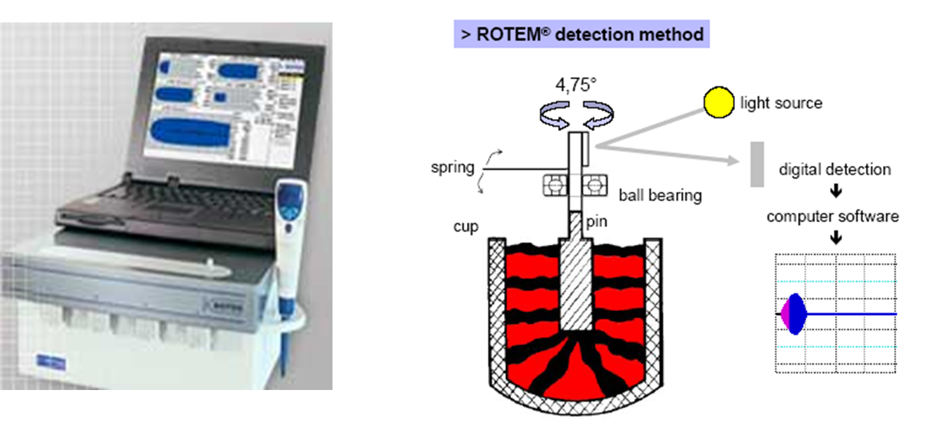
Thromboelastography

Slide 14
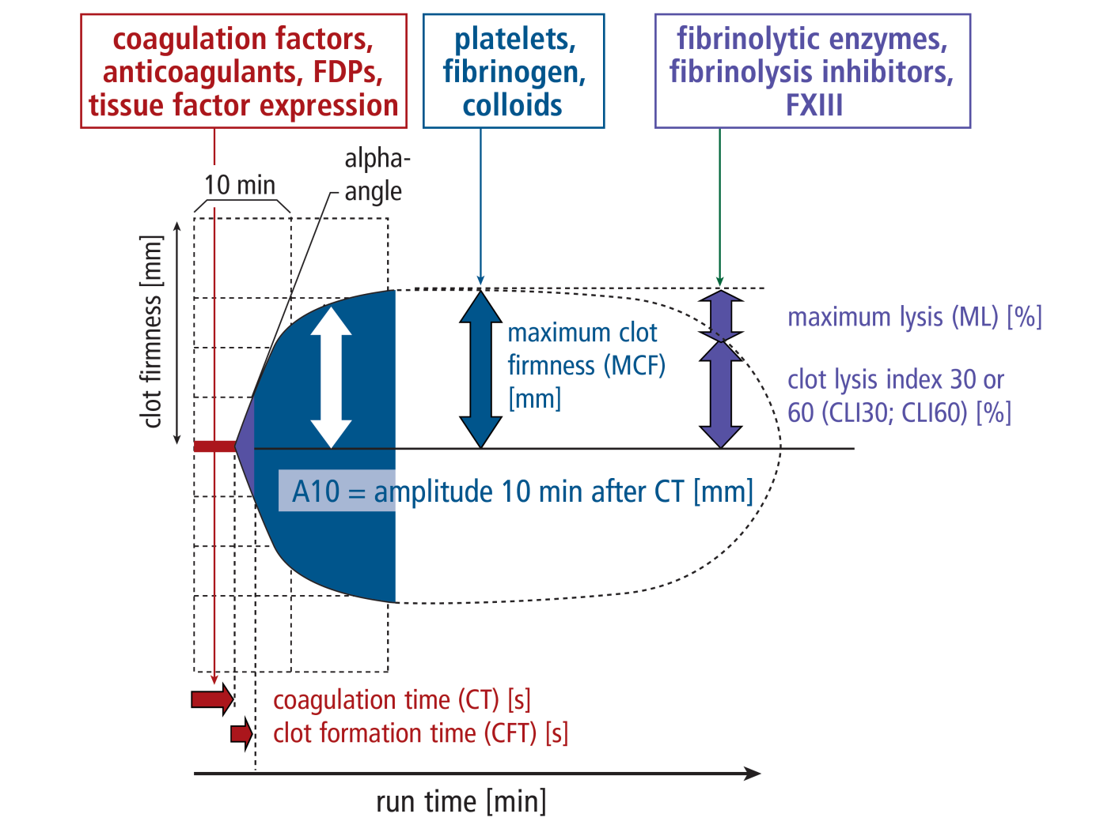
Exemple: normal ROTEM output
Lier et al, Haemostaseologie 2013; 33:51-61

Slide 15
Thrombelastometry: Tests
INTEM®
Intrinsic Activator (similar to APTT)
EXTEM®
Extrinsic Activator (similar to Quick)
HEPTEM®
Intrinsic Activator + Heparinase
FIBTEM®
Extrinsic Activator + Inhibition of Platelets
APTEM®
Extrinsic Activator + Aprotinin
Notes:
There are 5 different test available vor clincal routine:
First we do have two standard tests such as INTEM and EXTEM. The Intem-test is activated by an intrinsic activator similar to APTT, the extem test is activated by an extrinsic activator similar to Quick.
At least there are three special test available, the HEPTEM, the FIBTEM and the APTEM, which I will discuss in the following.
Now this was the cumbersome and the boring part of my presentation and I hope you are not sleepe becaus in the following I will try to demonstrate the usefulness of thrombelastography for clinical problems.

Slide 16
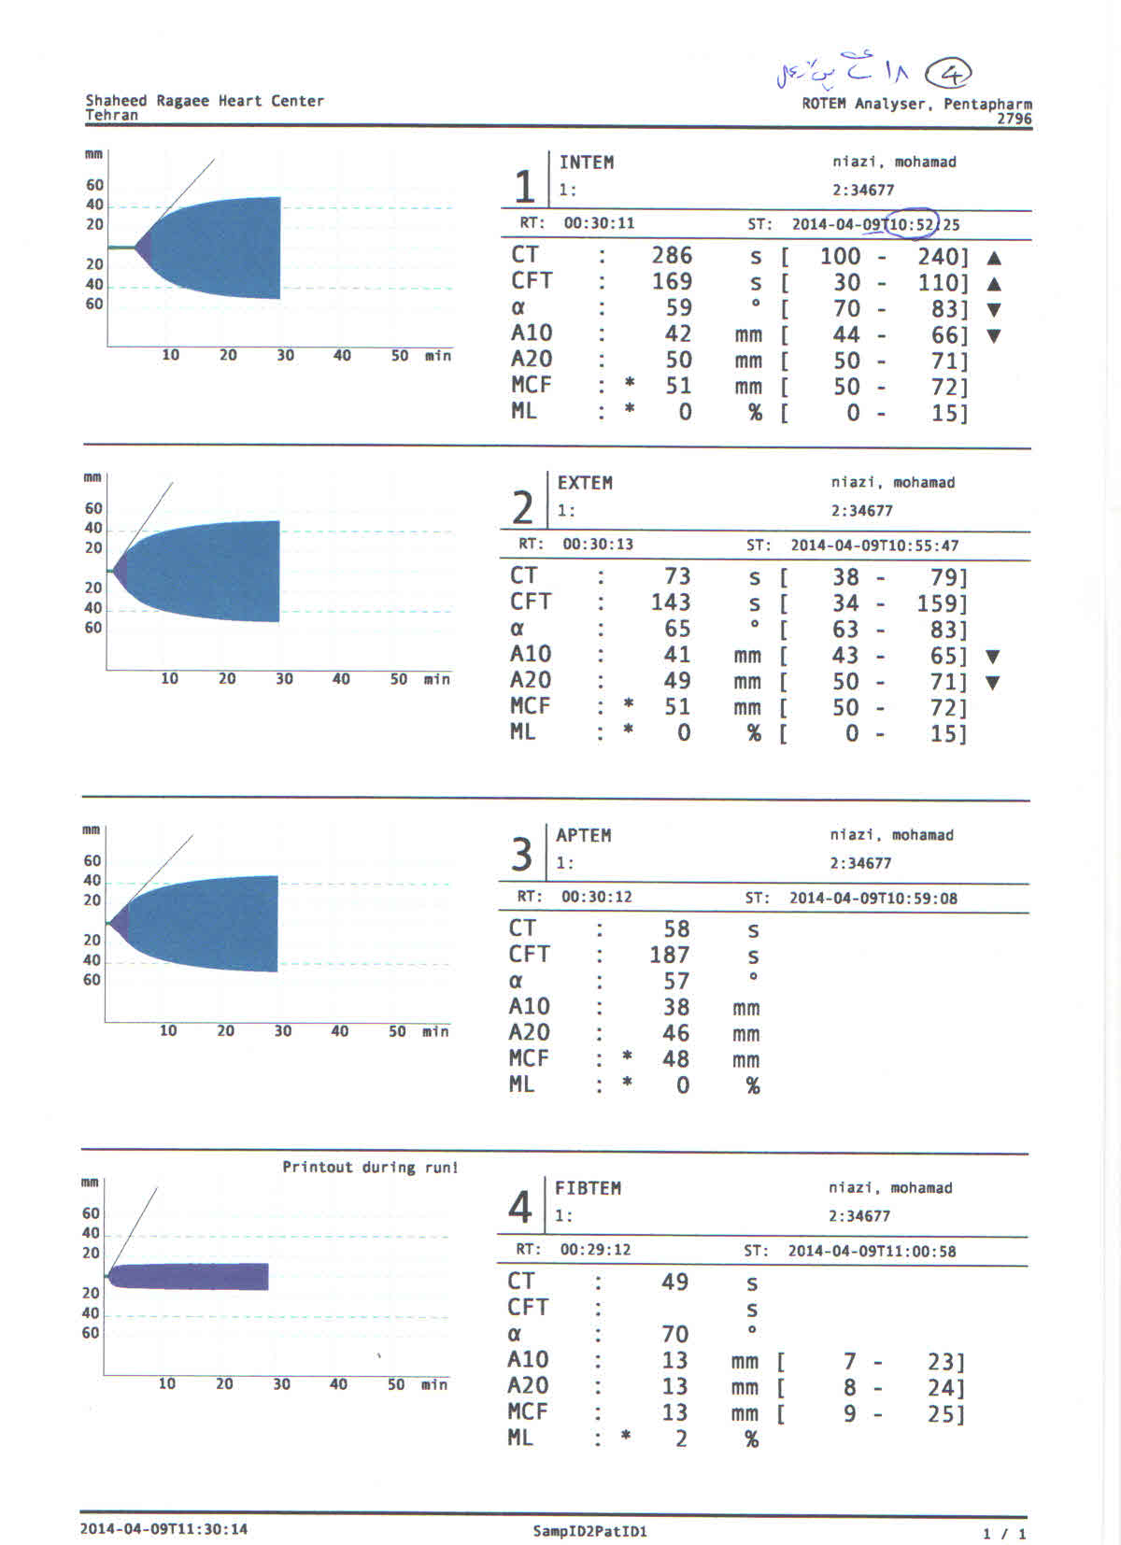

Slide 18
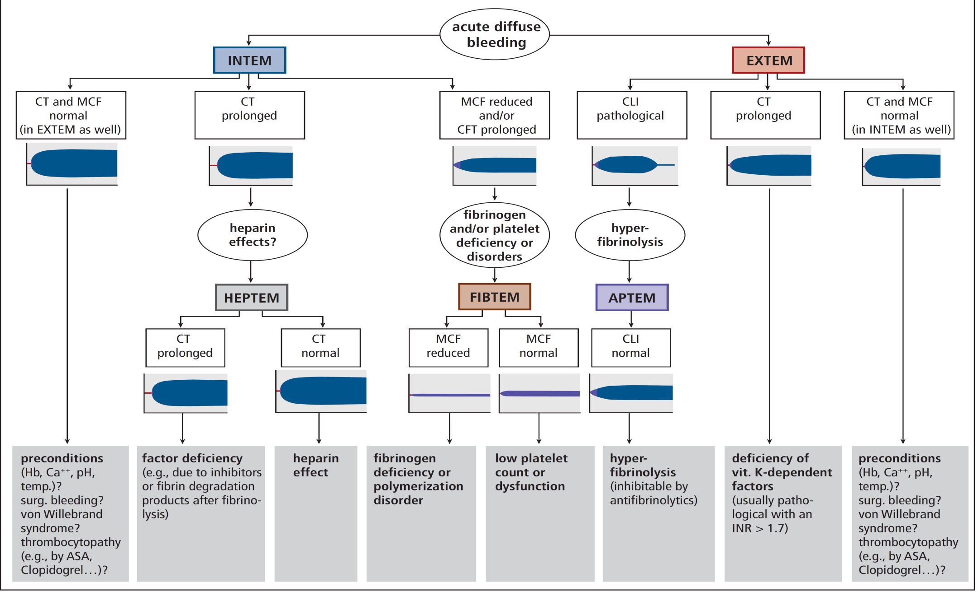
ROTEM algorithm for diagnosis
Lier et al, Haemostaseologie 2013; 33:51-61

Slide 19
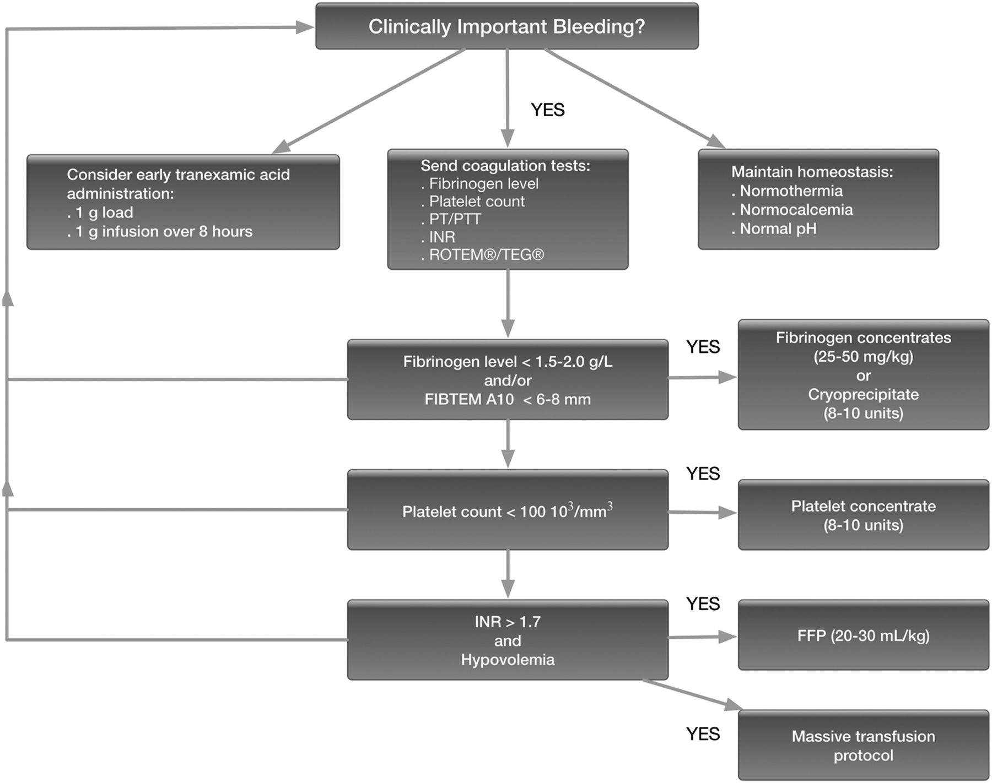

Fibrinogen algorithm.
Jerrold H. Levy, and Lawrence T. Goodnough Blood 2015;125:1387-1393
©2015 by American Society of Hematology
Notes:
Fibrinogen algorithm. Suggested management strategy for the bleeding patient with a focus on fibrinogen measurement and repletion strategies.

Slide 20
انديكاسيون هاي استفاده از ROTEM
(پروتكل مصوب بيمارستان شهيد رجايي)
جراحي آنوريسم آئورت
Total Circulatory Arrest in CPB
پمپ تايم بيش از 120 دقيقه
استفاده از دو يا چند داروي ضد پلاكتي
خونريزي بيش از 200 cc/h پس از عمل
كاهش بيش از 1g/dl/h هموگلوبين پس از عمل
بيماري همراه كبدي يا كليوي يا اختلال شناخته شده انعقادي
اعمال جراحي كمپلكس قلبي
اعمال جراحي مجدد
اعمال جراحي اورژانس

Slide 21
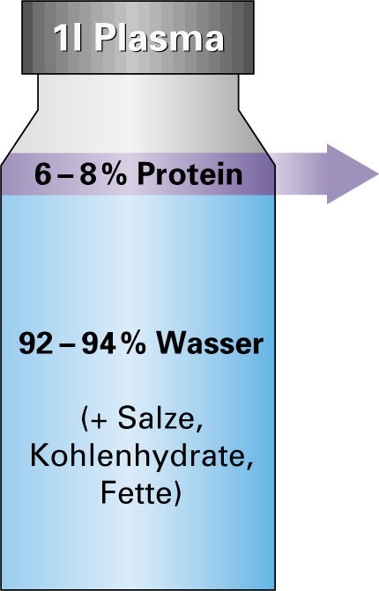

Composition of human plasma (FFP)
      40 - 50 g/l Albumin
      10 - 25 g/l Immuno globulins
      2 - 4 g/l Fibrinogen
      9 - 10 g/l 6 other highly concentrated proteins
      (transferrin, haptoglobin, C₃,
      α₂-Macroglobulin, α₁-Proteinase-Inhibitor,
      Apolipoprotein I)
      8,5 g/l approx. 110 additional plasma proteins
      (among them clotting factors and
      inhibitors)
92-94%Others:
  Water
  Salts
  Fat
The amount of active substances in FFP is clearly < 1% of total volume

Slide 22
Cryoprecipitate
Factor | Content in cryoprecipitate
Fibrinogen | Approx. 350 mg, 30-50 % of the original plasma (min.150 mg)
Factor VIII | 5% of total protein
Factor XIII | 20-30% of the original factor XIII
Fibronectine | 1500 mcg/mL – 20-25% of original plasma (N=300mcg/mL)
Platelet microparticles | x 265 times more than in original plasma
IgG | 5-8% of original plasma
Ig M | 1-2% of original plasma
Albumin | 5-8% of original plasma
Frequently used in US and Canada, no longer in EU
Callum et al., Transfusion Medicine Reviews, Vol 23, No 3 (July), 2009: pp 177-188

Slide 23
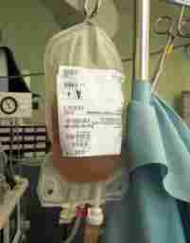
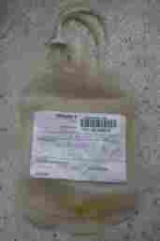
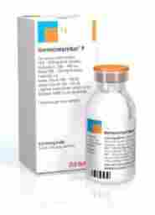
What are the options for supplementing fibrinogen?
Fibrinogen concentrate
Therapeutic plasma
Cryoprecipitate
To raise the plasma fibrinogen concentration by 1 g/L in a 70-kg adult:
>1000 mL FFP OR 260 mL cryoprecipitate OR 2g Fbg /100 mL
Stainsby D et al, Br J Haematol 2006;135: 634–41. Chowdhury P et al, Br J Haematol 2004;125:69–73 ;
Bolton-Maggs PHB et al., Haemophilia 2004;10:593–628.
Notes:
Supplementation of plasma fibrinogen can be carried out via administration of fresh frozen plasma (FFP), cryoprecipitate, or fibrinogen concentrate. These options vary significantly in their efficacy, safety and speed of infusion.
FFP is an allogeneic blood product containing all components of human plasma at or below normal physiological concentrations. The average concentration of fibrinogen in FFP is ~2 g/L,¹ limiting the extent to which it can raise fibrinogen levels. Infusion volumes to reach the target fibrinogen level are often high or even unfeasible, and there may be a risk of fluid overload. Accurate dosing is impossible due to variable concentrations of coagulation factors.
Standard FFP does not undergo viral inactivation and is therefore associated with a theoretical risk of pathogen transmission. Also, allogeneic blood products contain antigens and antibodies that can cause reactions such as transfusion-associated acute lung injury (TRALI).
The need for cross-matching and thawing before administration, as well as high infusion volumes, means that administration of FFP is slow, potentially compromising outcomes in emergency situations.
Cryoprecipitate is quicker to administer than FFP due to smaller infusion volumes, but cross-matching and thawing are still required.
In contrast, fibrinogen concentrate is stored as a lyophilised powder. It is easily prepared using sterile water (50 mL per 1 g vial); this can be done in 3 minutes. Blood group matching is not required, no thawing or warming is necessary, and infusion volumes are low.
Ketchum L, et al. J Trauma 2006;60:S51–8

Slide 24
Why bother about allogeneic RBC, FFP and platelets ?
RBC, FFP and platelet transfusions are associated with major adverse outcome
Mortality
Major morbidity (ischemia)
Infection
TRALI, TACO
Transfusion reaction
Length of stay in ICU
Costs
Kulier A. et al. Circulation (2007) 116: 471
Murphy G. J. et al. Circulation (2007) 116: 2544 (RBC)
Karkouti K. et al. Circulation (2008) 117: 478

Slide 25
1- Management of severe perioperative bleeding
Guidelines from the European Society of Anaesthesiology
7. COAGULATION MANAGEMENT
7.1.2 Fibrinogen concentrate
Recommendation
We recommend treatment with ﬁbrinogen concentrate if
signiﬁcant bleeding is accompanied by at least suspected low ﬁbrinogen concentrations or function. 1C
We recommend that a plasma ﬁbrinogen concentration<1.5–2.0 g/l or ROTEM/TEG signs of functional ﬁbrinogen deﬁcit should be triggers for ﬁbrinogen substitution. 1C
7.1.3 Cryoprecipitate
Recommendation
We suggest that the indication for cryoprecipitate is lack of available ﬁbrinogen concentrate for the treatment of bleeding and hypoﬁbrinogenaemia. 2C

Slide 26
2- Practice Guidelines for Perioperative Blood Management
An Updated Report by the American Society of Anesthesiologists
Task Force on Perioperative Blood Management*
This is the most recent published guideline by American society of anesthesiology. However Fibrinogen administration is very new in US, but they have some direct hints to: 1- consider Fibrinogen assay as a standard coagulation test and 2- consider the use of fibrinogen concentrate in patients with low fibrinogen level
Monitoring for Coagulopathy
Monitoring for coagulopathy includes standard coagulation tests (e.g., INR, activated partial thromboplastin time [aPTT], fibrinogen concentration), as well as platelet count. Additional monitoring for coagulopathy may include tests of platelet function, and viscoelastic assays (e.g., TEG, ROTEM).
Treatments for Hypofibrinogenemia:
Literature Findings: The literature is insufficient to evaluate the intraoperative or postoperative transfusion of
cryoprecipitate to manage hypofibrinogenemia. RCTs com- paring fibrinogen concentrate with placebo report a lower volume of RBC transfusion and a reduced frequency of patients transfused when fibrinogen concentrate is adminis- tred intraoperatively (Category A2-B evidence).
Survey Findings: The consultants and ASA members both agree that, in patients with excessive bleeding, consider the use of fibrinogen concentrate.

Slide 27
Acta Anaesthesiol Scand. 2018 Dec 3. doi: 10.1111/aas.13295. [Epub ahead of print]
Effects of fibrinogen and platelet transfusion on coagulation and platelet function in bleeding cardiac surgery patients.
Shams Hakimi C¹, Singh S¹, Hesse C², Jeppsson A^{1,3}.
RESULTS: Fibrinogen infusion resulted in an increase in fibrinogen concentration and clot stability (P = 0.001), but had no effect on platelet aggregation. Platelet transfusion did not significantly affect coagulation, but improved arachidonic acid- and TRAP-induced platelet aggregation (P = 0.017 and 0.034 respectively) and increased platelet count. Combined fibrinogen and platelet transfusion shortened clotting time (P = 0.005) and increased clot stability (P = 0.001), and improved arachidonic acid- and TRAP-induced platelet aggregation (P = 0.004 and 0.016 respectively), and increased fibrinogen concentration and platelet count. The median bleeding volume was 150 (25th-75th percentile 70-240) mL/h before, and 60 (40-110) mL/h after transfusion of fibrinogen and/or platelet concentrate (P < 0.001).
CONCLUSION: The results demonstrate improved coagulation and platelet function following fibrinogen and platelet transfusion in patients bleeding after cardiac surgery.

Slide 28
PLoS One. 2018 Aug 3;13(8):e0201647. eCollection 2018.
Short-term recovery pattern of plasma fibrinogen after cardiac surgery: A prospective observational study.
Erdoes G¹, Dietrich W², Stucki MP¹, Merz TM³, Angelillo-Scherrer A⁴, Nagler M⁴, Carrel T⁵, Eberle B¹.
Abstract
Low plasma fibrinogen level is common after cardiopulmonary bypass (CPB). The aim of this study was to determine the short-term recovery pattern of plasma fibrinogenafter CPB weaning. Our hypothesis was that in the absence of surgical bleeding, CPB-induced hypofibrinogenemia would resolve spontaneously and predictably within a few hours. In a prospective, observational study of 26 patients undergoing conventional CPB (cCPB) or minimally invasive extracorporeal circulation (MiECC), Clauss fibrinogen level (C-FIB) was determined at 10 closely spaced time points after protamine administration. Primary endpoint was the time to recovery of post-CPB fibrinogen levels to ≥1.5 g/L. C-FIB reached its nadir after protamine administration corresponding to 62 ± 5% (mean ± SD) of the baseline level after cCPB and 68 ± 7% after MiECC (p = 0.027 vs. cCPB). C-FIB recovered spontaneously at a nearly constant rate of approximately 0.08 g/L per hour. In all patients, C-FIB was ≥1.5 g/L at 4 hours and ≥2.0 g/L at 13 hours after CPB weaning.
Following cardiac surgery with CPB and in the absence of surgical bleeding, spontaneous recovery of normal endogenous fibrinogen levels can be expected at a rate of 0.08 g/L per hour. Administration of fibrinogen concentrate triggered solely by a single-point measurement of low plasma fibrinogen some time after CPB is not justified.

Slide 29
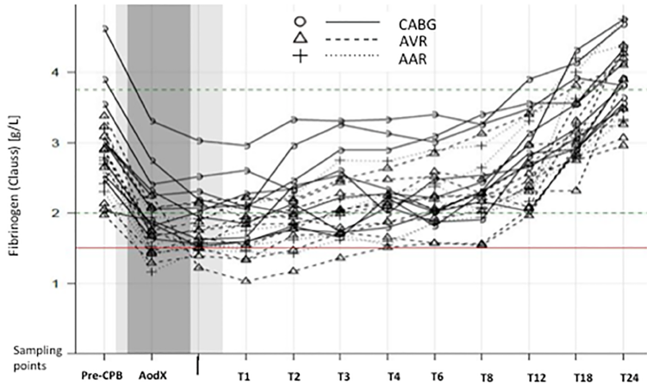

Slide 30
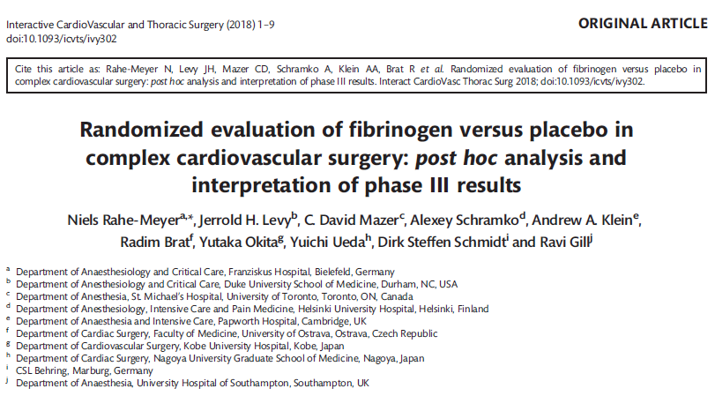

Slide 31
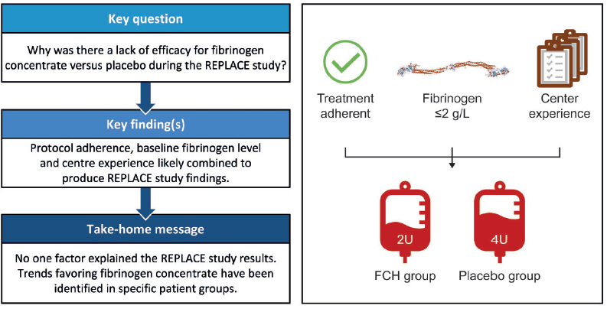

Slide 32
Clin Appl Thromb Hemost. 2018 Dec 5:1076029618816382.
Correlation Between ROTEM FIBTEM Maximum Clot Firmness and Fibrinogen Levels in Pediatric Cardiac Surgery Patients.
Tirotta CF¹, Lagueruela RG¹, Madril D¹, Salyakina D², Wang W², Taylor T², Ojito J³, Kubes K³, Lim H³, Hannan R³, Burke R³.
Author information
Abstract
This study evaluated whether rotational thromboelastometry (ROTEM; Tem International GmbH, Munich, Germany) FIBTEM maximum clot firmness (MCF) can be used to predict plasma fibrinogen level in pediatric patients undergoing cardiac surgery. Linear regression was conducted to predict plasma fibrinogen level using FIBTEM MCF (0.05 level of significance). Scatter plot with the regression line for the model fit was created. Fifty charts were retrospectively reviewed, and 87 independent measurements of FIBTEM MCF paired with plasma fibrinogen levels were identified for analysis. Linear regression analysis suggested a significant positive linear relationship ( P < .0001) between plasma fibrinogen levels and MCF. Both MCF intercept and slope were significantly correlated with fibrinogen level ( P < .0001). The estimated regression equation (predicted fibrinogen = 78.6 + 12.4 × MCF) indicates that a 1-mm increase in MCF raises plasma fibrinogen level by an average of 12.4 mg/dL. The statistically significant positive linear relationship observed between MCF and fibrinogen levels ( P < .001) suggests that MCF can be used as a surrogate for fibrinogen level. This relationship is of clinical relevance in the calculation of patient-specific dosing of fibrinogen supplementation in this setting.

Slide 33
JAMA. 2017 Feb 21;317(7):738-747. doi: 10.1001/jama.2016.21037.
Effect of Fibrinogen Concentrate on Intraoperative Blood Loss Among Patients With Intraoperative Bleeding During High-Risk Cardiac Surgery: A Randomized Clinical Trial.
Bilecen S¹, de Groot JA², Kalkman CJ³, Spanjersberg AJ⁴, Brandon Bravo Bruinsma GJ⁵, Moons KG⁶, Nierich AP⁴.
INTERVENTIONS: Intravenous, single-dose administration of fibrinogen concentrate (n = 60) or placebo (n = 60), targeted to achieve a postinfusion plasma fibrinogen level of 2.5 g/L.
RESULTS:
Among 120 patients (mean age; 71 [SD, 10] years, 37 women [31%]) included in the study, combined CABG and valve repair or replacement surgery comprised 72% of procedures and had a mean (SD) cardiopulmonary bypass time of 200 minutes (83) minutes. For the primary outcome, median blood loss in the fibrinogen group was 50 mL (interquartile range [IQR], 29-100 mL) compared with 70 mL (IQR, 33-145 mL) in the control group (P = .19), the absolute difference 20 mL (95% CI, -13 to 35 mL). There were 6 cases of stroke or transient ischemic attack (4 in the fibrinogen group); 4 myocardial infarctions (3 in the fibrinogen group); 2 deaths (both in the fibrinogen group); 5 cases with renal insufficiency or failure (3 in the fibrinogen group); and 9 cases with reoperative thoracotomy (4 in the fibrinogen group).
CONCLUSIONS AND RELEVANCE:
Among patients with intraoperative bleeding during high-risk cardiac surgery, administration of fibrinogen concentrate, compared with placebo, resulted in no significant difference in the amount of intraoperative blood loss.
TRIAL REGISTRATION:
clinicaltrials.gov Identifier: NCT01124981 and EudraCT No: 2009-018086-12.

Slide 34
Br J Anaesth. 2016 May;116(5):618-23. doi: 10.1093/bja/aev539. Epub 2016 Feb 17.
Fibrinogen supplementation after cardiac surgery: insights from the Zero-Plasma trial (ZEPLAST).
Ranucci M¹, Baryshnikova E².
RESULTS:
There was a good association between FIBTEM MCF and Clauss fibrinogen concentration in the baseline study population (r(2) = 0.66), which worsened in fibrinogen-supplemented subjects. Both FIBTEM MCF and Clauss fibrinogen concentration yielded a good discriminative power for SB (area under the curve 0.721 and 0.767, respectively). The negative predictive value for Severe Bleeding (SB) was 100% for a Clauss fibrinogen concentration of 287 mg dl(-1) and 98% for an FIBTEM MCF of 14 mm. Based on these newly defined target values, the dose of fibrinogen concentrate needed would be 3 g lower than the dose used in ZEPLAST.
CONCLUSIONS:
A dose of fibrinogen concentrate rarely exceeding 2 g might be sufficient to prevent bleeding in cardiac surgery.

Slide 35
Journal of Cardiothoracic and Vascular Anesthesia Volume 28, Issue 2, April 2014, Pages 210–216
Rapid and Correct Prediction of Thrombocytopenia& Hypofibrinogenemia With Rotational Thromboelastometry in Cardiac Surgery
Rik H.G. Olde Engberink, MD*, , , Gerhardus J.A.J.M. Kuiper, MD†, Rick J.H. Wetzels, MSc§, Patty J. Nelemans, MD, PhD‡, Marcus D. Lance, MD†, Erik A.M. Beckers, MD, PhD*, Yvonne M.C. Henskens, PhD§
Results: EXTEM A5 and FIBTEM A5 showed an excellent correlation with A10 (R:0.99/1.00) and MCF (R:0.97/0.99). The correlation between EXTEM A5 and platelet count (R:0.74) was comparable with the correlation of A10 (R:0.73) and MCF (R:0.70) with platelet count. FIBTEM A5 predicted fibrinogen levels (R:0.87) as well as A10 (R:0.86) and MCF (R:0.87). PLTEM A5 (R:0.85) correlated better with platelet count than EXTEM A5 (R:0.74; p = 0.04) and showed significantly better area under the curve values than EXTEM for predicting thrombocytopenia (A5 p = 0.012, A10 p = 0.019). Turnaround time for ROTEM tests, 12 minutes, was comparable with emergency requests for platelet count, 13 minutes, and shorter than emergency requests for fibrinogen levels, 37 minutes.
Conclusions: Implementation of PLTEM and FIBTEM A5 in ROTEM-guided transfusion protocols may improve transfusion management.

Slide 36
Results. Thirty-nine patients receiving fibrinogen concentrate for diffuse bleeding requiring haemostatic therapy after cardiopulmonary bypass were identified. The mean fibrinogen concentrate dose administered was 6.5 g. The mean fibrinogen level increased from 1.9 to 3.6 g litre21 (mean increment of 0.28 g litre21 per gram of concentrate administered); maximum clot firmness increased from 10 to 21 mm. The mean fibrinogen increase was 2.29 (SD 0.7) mg dl21 per mg kg21 bodyweight of concentrate administered. Thirty-five (89.7%) patients received no transfusion of fresh-frozen plasma (FFP) or platelet concentrate after receiving fibrinogen concentrate; the remaining four patients received platelet concentrate intraoperatively. Eleven patients received platelets, FFP, or both during the first postoperative day. No venous thromboses, arterial ischaemic events, or deaths were registered during hospitalization.
Conclusions. In this retrospective study, fibrinogen concentrate was effective in increasing plasma fibrinogen level, and contributed to the correction of bleeding after cardiovascular surgery. Br J Anaesth 2010; 104: 555–62

Slide 38
The patients who received fibrinogen concentrate (FIB group) were compared with the patients who did not received (non Fib group). There were 147 patients (68%) in FIB group at a dose of 5.5±3.5 g. The SFL were dramatically decreased with values of 164±71 mg/dl at CPB termination, compared to the preoperative SFL of 352±131 mg/dl. In the FIB group, the intraoperative and postoperative SFLs were 139±53 and 262±75 (mg/dl), respectively. Thus the SFL was recovered quickly by the administration. 110 cases (51%) showed hypofibrinogenemia at the termination of CPB. The predictors of hypofibrinogenemia were preoperative SFL < 250 mg/dl, emergency surgery and thracoabdominal aortic surgery.
Hypofibrinogenemia frequently was observed at the termination of CPB during thoracic aortic surgery. Administering intraoperative fibrinogen concentrate appears to be a useful option to treat coagulopathy.

Slide 39
Plasma fibrinogen concentration is correlated with postoperative blood loss in children undergoing cardiac surgery: A retrospective review
Faraoni, David; Willems, Ariane; Savan, Veaceslav; Demanet, Helene; De Ville, Andree; Van der Linden, Philippe
European Journal of Anaesthesiology: June 2014 - Volume 31 - Issue 6 - p 317–326
RESULTS: Thirty-six children were considered as ‘bleeders’ and 120 as ‘nonbleeders’. Univariate and multivariate logistic regression analysis revealed time for wound closure, clot formation time, maximal clot firmness (MCF) and plasma fibrinogen concentration as variables independently associated with postoperative bleeding. MCF was best correlated with plasma fibrinogen concentration. ROC curves for blood loss versus fibrinogen concentration and MCF showed that a plasma fibrinogen concentration of 1.5 g l⁻¹ and a MCF value 3 mm or less could be used to predict blood loss.
CONCLUSION: Post-CPB plasma fibrinogen concentration significantly influences blood loss in children undergoing cardiac surgery. A fibrinogen concentration of at least 1.5 g l⁻¹ or a MCF of at least 3 mm should accurately predict excessive blood loss in cardiac surgery children. Further prospective trials are needed to assess the effect of fibrinogen supplementation on postoperative blood loss in this population.

Slide 40

Hemostatic effects of fibrinogen concentrate compared with cryoprecipitate in children after cardiac surgery: A randomized pilot trial
Filomena R.B.G. Galas, MD, PhD, Juliano P. de Almeida, MD, PhD, Júlia T. Fukushima, MSc , Jean Louis Vincent, MD, PhD , Eduardo A. Osawa, MD, PhD, Suely Zeferino
Oct 2014,
Conclusions
A large trial comparing fibrinogen concentrate and cryoprecipitate in the management of children with acute acquired hypofibrinogenemia during heart surgery is feasible. The preliminary results of our study showed that the use of fibrinogen concentrate was as efficient and safe as cryoprecipitate in the management of bleeding children undergoing cardiac surgery.

Slide 41
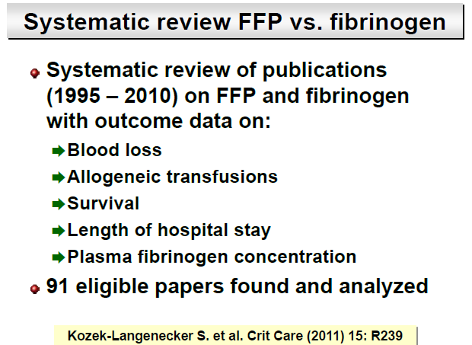

Slide 42
Blood products transfusion
(No. of operations per year ~4800)
 | 1391 (2012) | 1392 (2013) | 1393 (2014) Estimated
RBC Cross-Match | 9469 | 9056 | 7908
FFP | 4663 | 4584 | 3896
Platelet | 2880 | 3294 | 2107

Slide 43
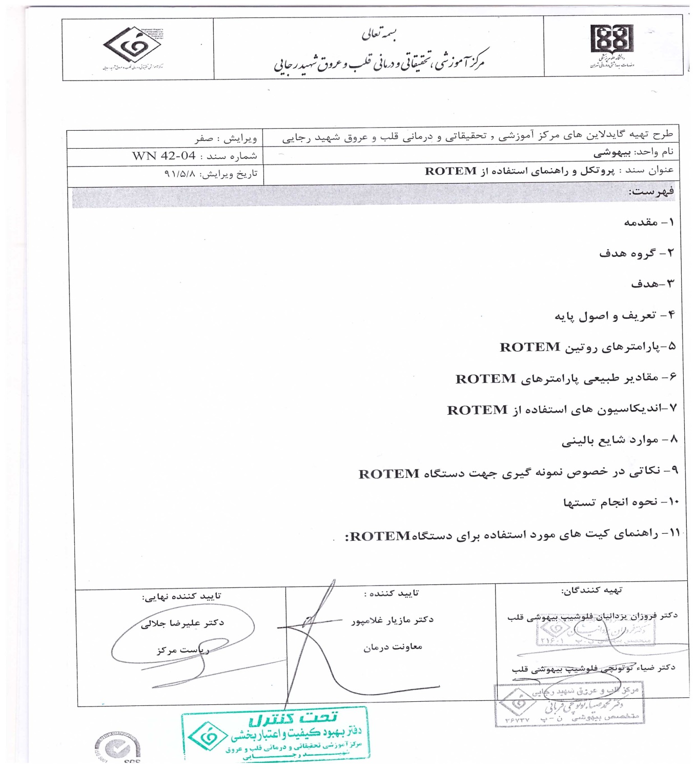
“Hemostatic Therapy Based on ROTEM” Protocol in
Rajaie Cardiovascular Medical & Research Center-Tehran

Slide 44
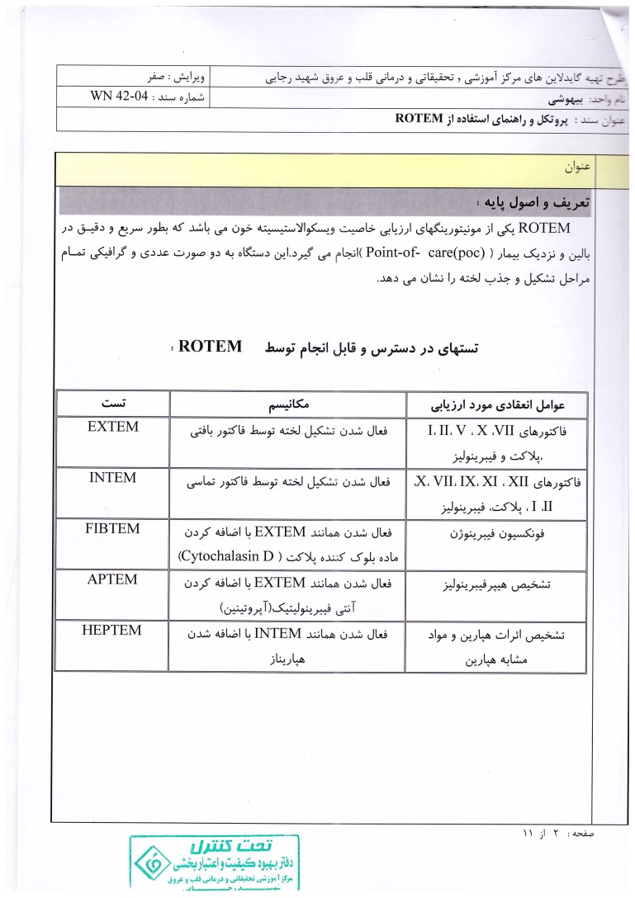

Slide 45
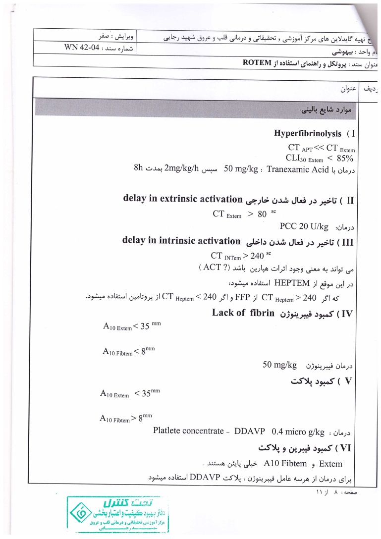

Slide 46
Case Report (1)
A 28 yrs old man with diagnosis of congenital aortic stenosis.
Underwent open heart surgery 5 times in 19-23 yrs ago (AV repair and AVR with homograft, AVR-prosthetic, Re-do AVR) and MVR 10 yrs ago.
Candidate for AV prosthesis pannus resection and CABG (SVG on RCA)
Echo: Severe RV systolic dysfunction, LVEF=45%
AVR+CABG was done; CPB time=2hrs 45min; Temp=30^{oc}

Slide 47
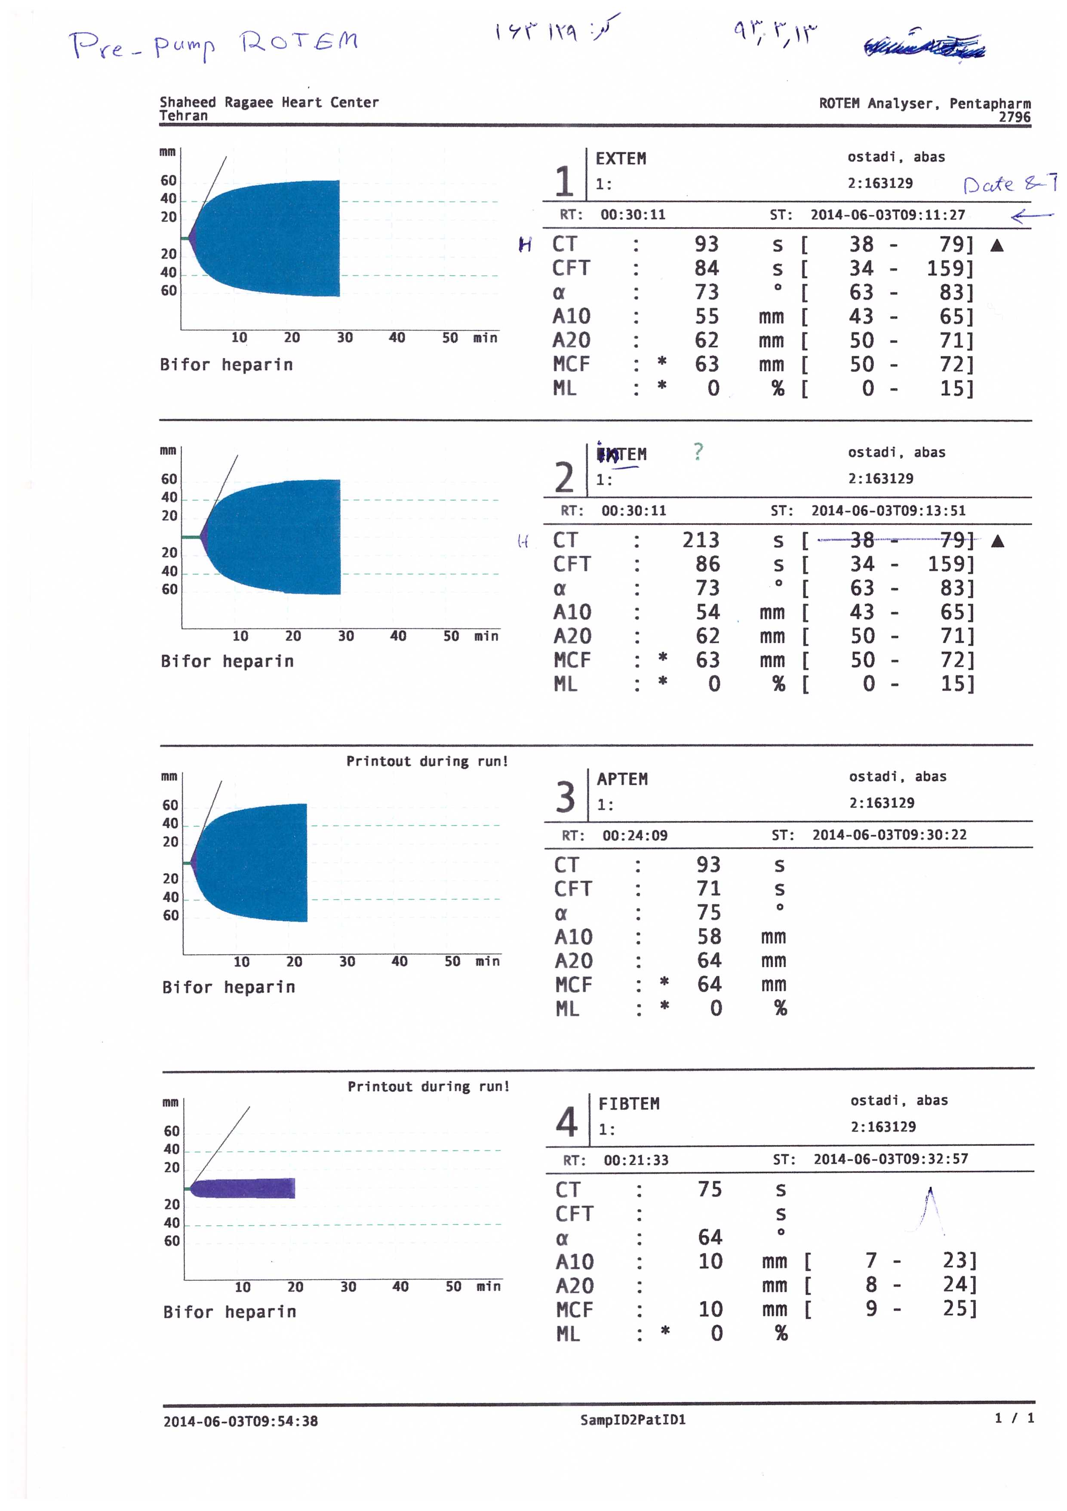


Baseline ROTEM
INTEM

Slide 48
There was significant oozing after CPB
Platelet concentrate= 5 units
FFP= 3 units
Hb=6.3 g/dl Packed RBC= 2 units
Fibrinogen= 2 gr
(There is no ROTEM immediately after CPB unfortunately!)
Sternum left open, and was closed the day after surgery (Mostly due to RV distention).

Slide 49
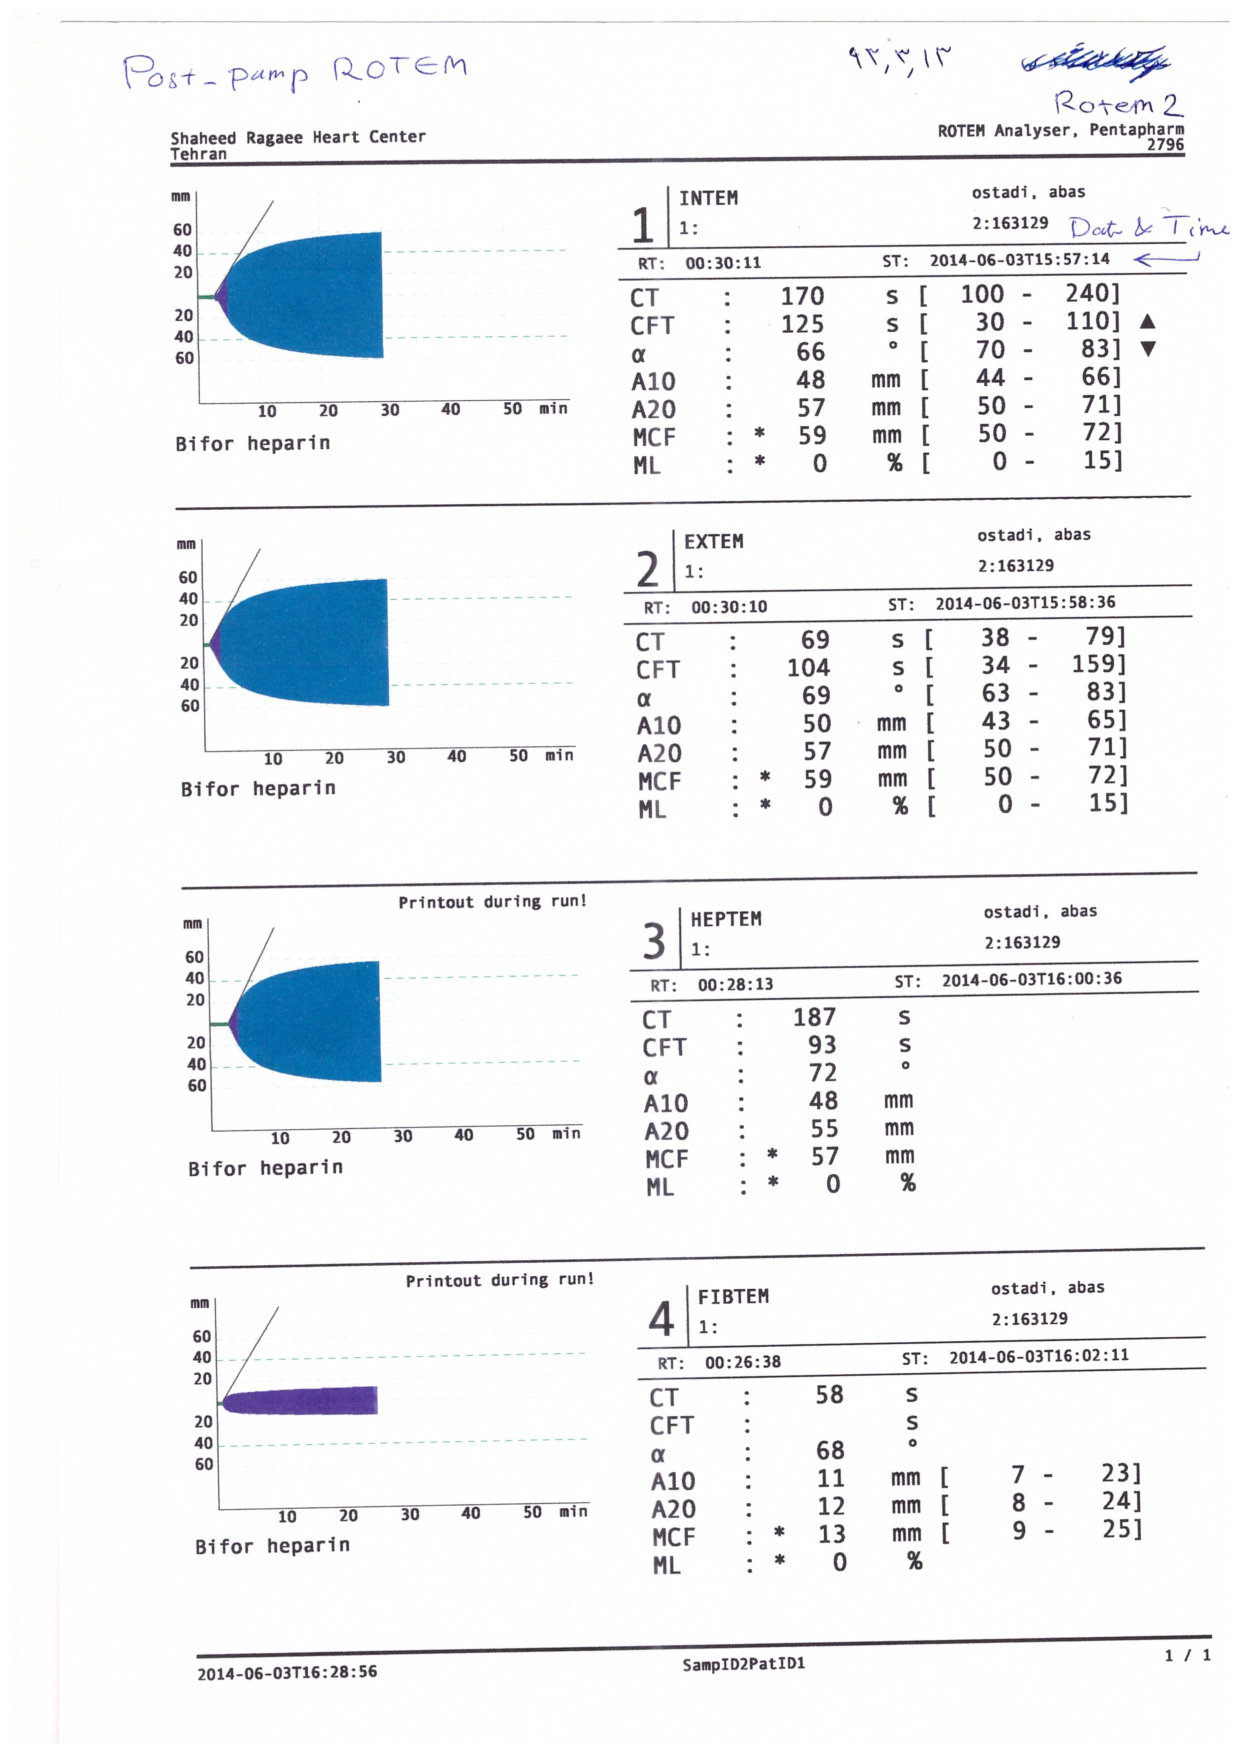

Post-CPB ROTEM (after hemostatic therapy)

Slide 50
Case Report (2)
A 18 yrs old man with pulmonary atresia+ Large VSD.
Hx of modified BT shunt 9 yrs ago.
Candidate for VSD closure+ modified Rastelly procedure (conduit + PVR).
Op time=7hr; CPB time=4hr 50min; lowest Temp=28^{oc}
Baseline Hb=20 gr/dl, lowest Hb=10.6 gr/dl.

Slide 51
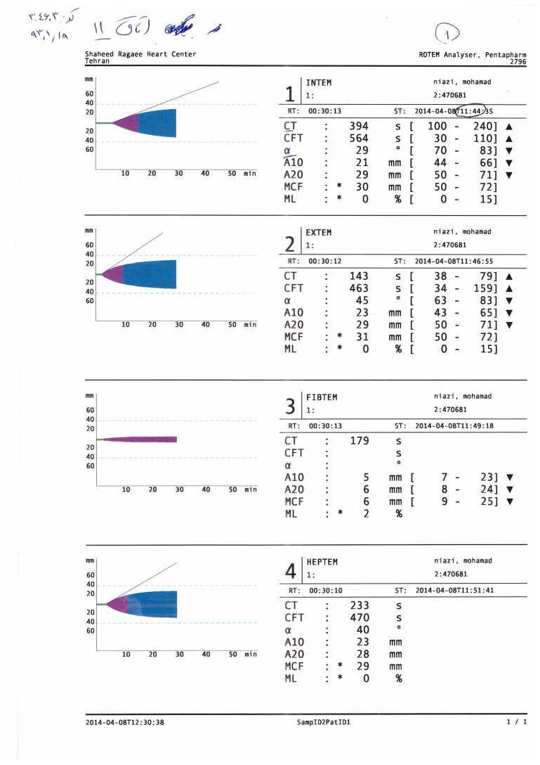
Baseline ROTEM

Slide 52
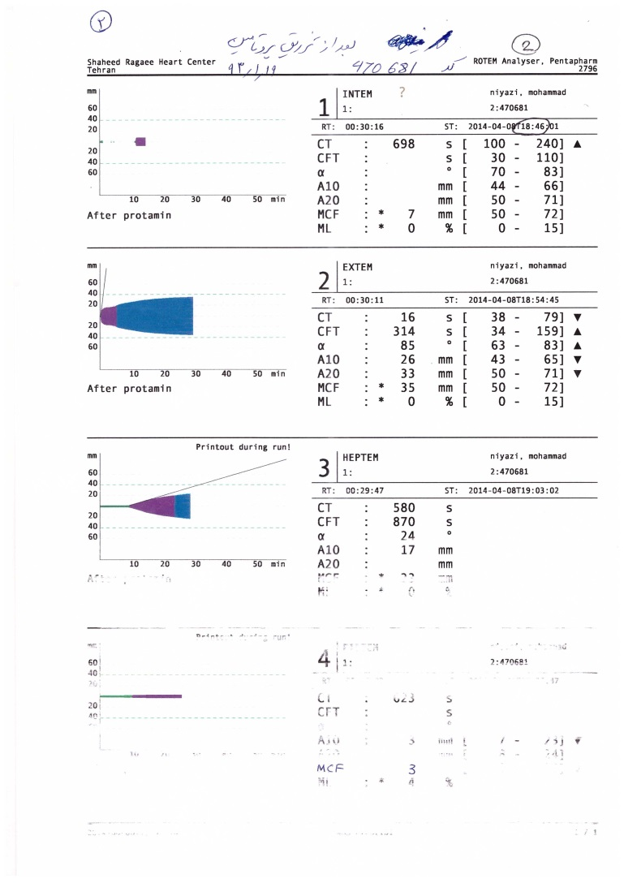
Post-CPB ROTEM (after protamine, before hemostatic therapy)

Slide 53
Hemostatic therapy
Platelet concentrate= 2 units
FFP= 2 units
Fibrinogen= 2 gr
Prothrombine complex concentrate (PCC)= 1000 IU (2 vials)

Slide 54
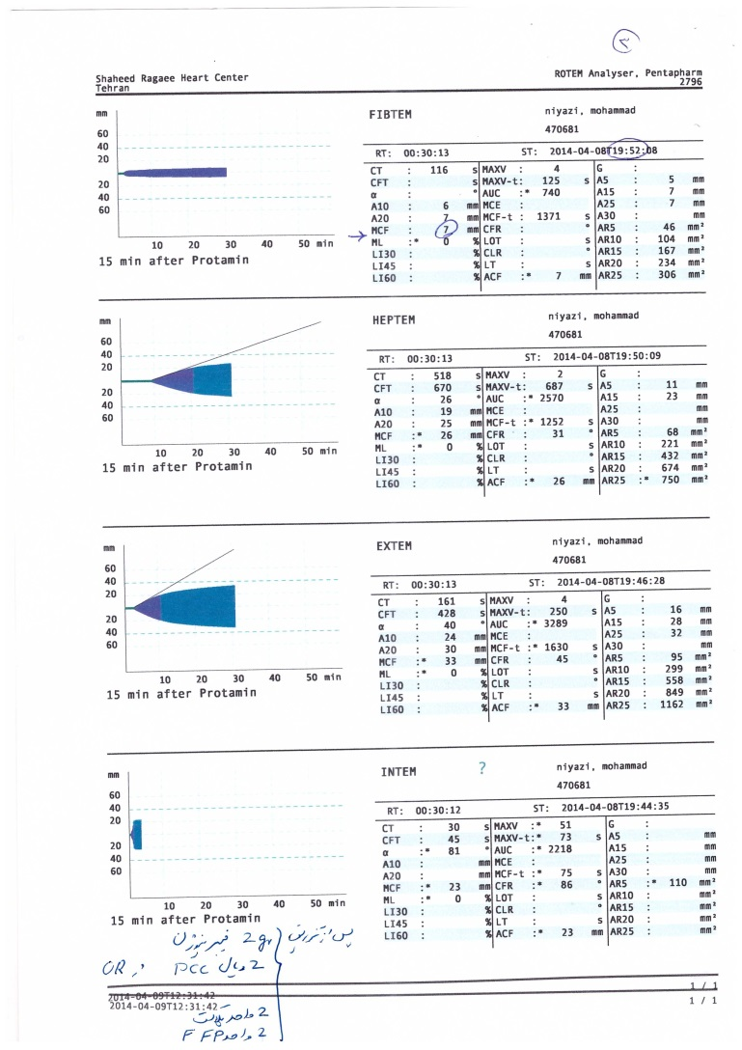
Post-CPB ROTEM 2 (after hemostatic therapy)

Slide 55
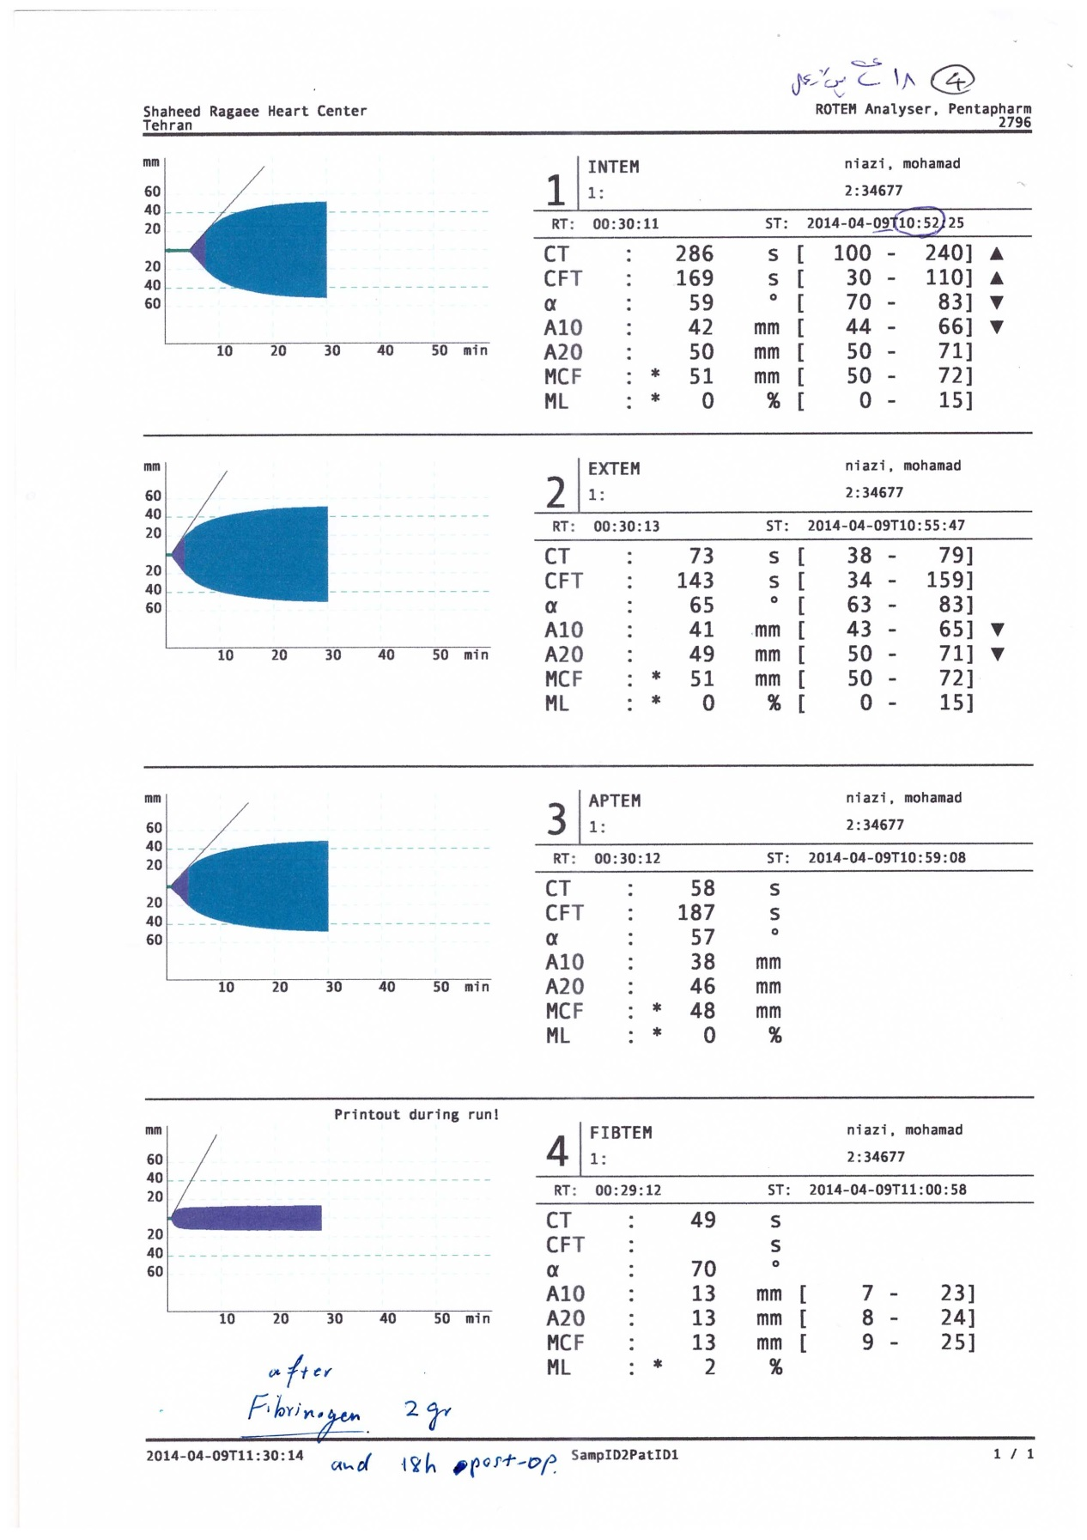
Post-op day 1 ROTEM (after 2nd fibrinogen 2 gr)

Slide 56
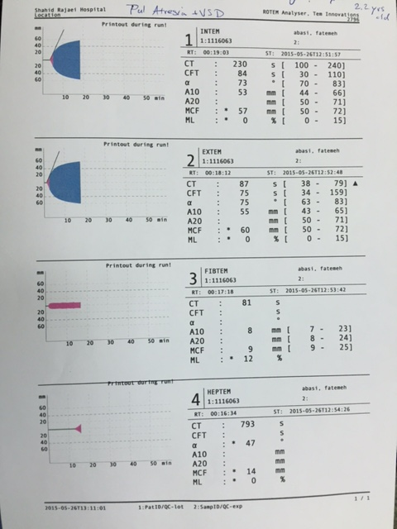
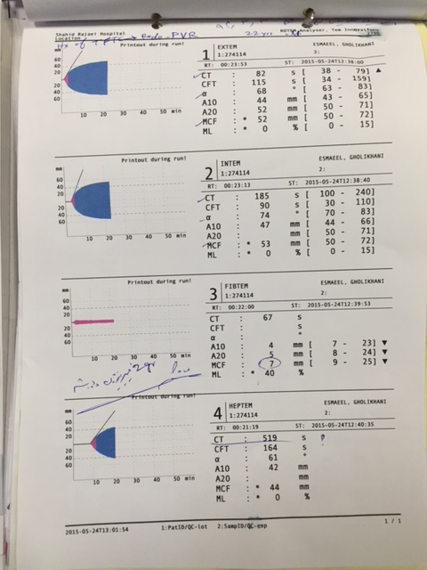
Hypofibrionogenemia in congenital heart dis.

Slide 57
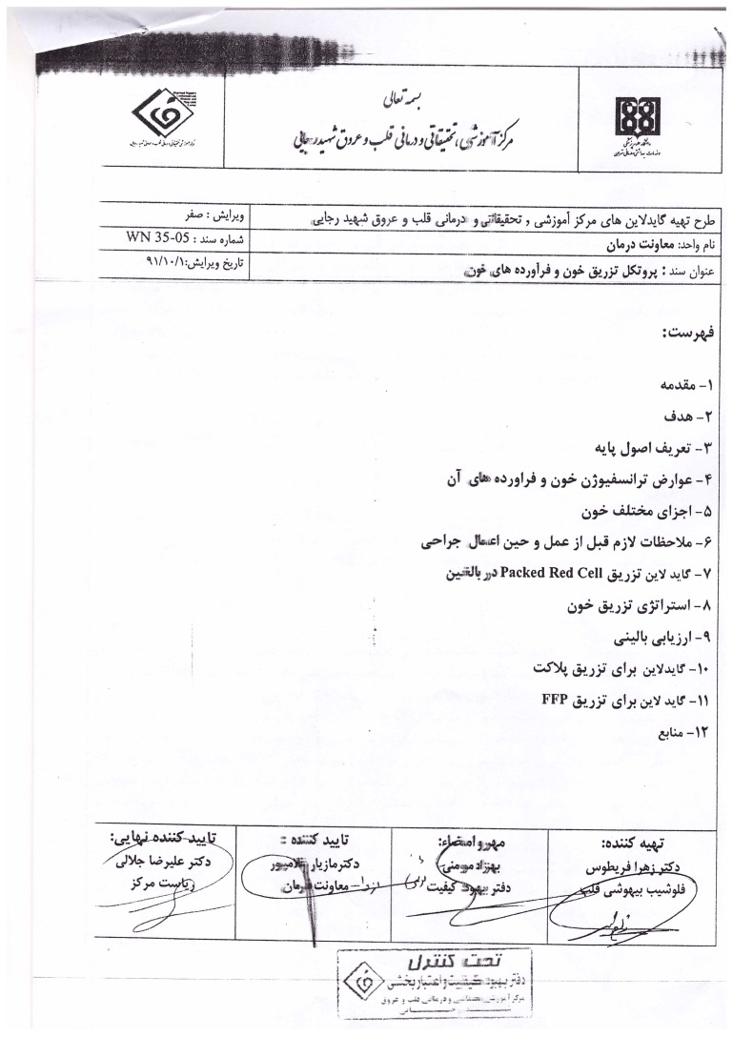

Slide 58
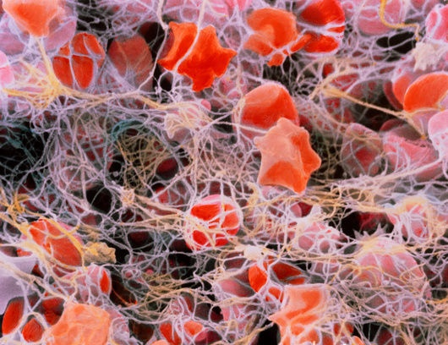
Thank You

